Slide 1

MOVIE INDUSTRY ANALYSIS
Prepared by group 3

Slide 2
Overview
This presentation is divided in different parts:
Objective
Methods
Data plots
Conclusions

Slide 3
Objectives
Which genre performs the best at the box office?
Which studios are the top performing based on revenue?
What role does the foreign market play in the industry's overall performance?
What impact does the budget have on movie performance?
What is the optimal time of year to release a movie for maximum success?
Do certain languages have a broader audience reach?
Who are the top-performing directors and writers in the industry?

Slide 4
Methods
The methods used in the analysis are as follows:
Data understanding
Data cleaning
Handling of missing values
Data handling so that it appears in a cohesive way
Data visualization
Data analysis
Drawing of conclusions

Slide 5
Data visualization and analysis

Slide 6
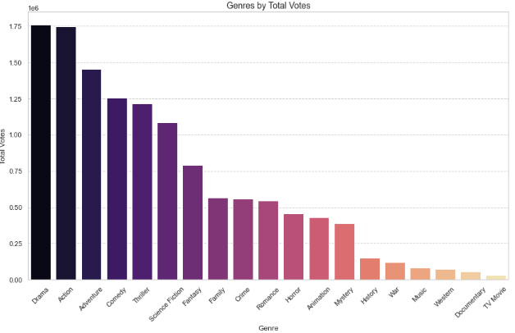

Slide 7
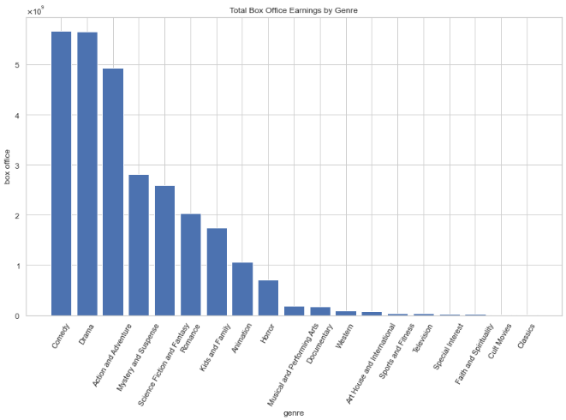

Slide 8
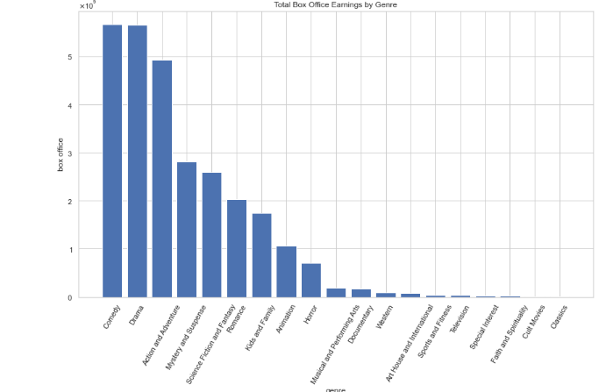
Conclusion: both sources indicate that 'Drama,' 'Comedy,' 'Action,' and 'Adventure' are the leading genres in terms of total vote counts and revenue generation. This suggests that focusing on these categories would likely yield the greatest benefits for the client.

Slide 9
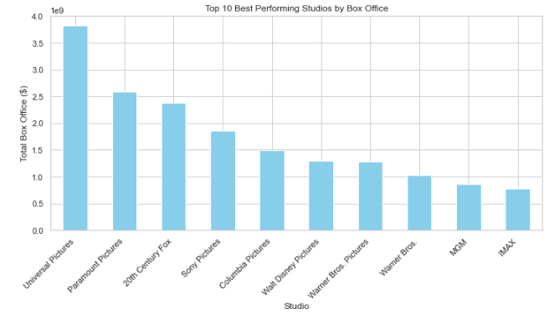

Slide 10
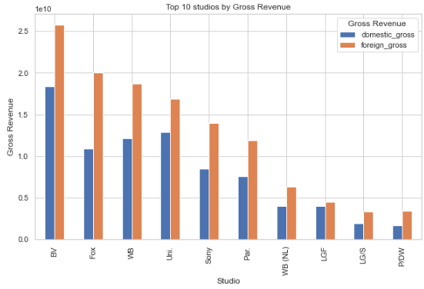

Slide 11
Conclusion: based on the analysis done, foreign gross significantly drives revenue for studios. The head of the company's new movies studio should ensure the studio invests in globally appealing content so as earn more reveunue.The studio can also consider collaborations with successful studios or talent.

Slide 12
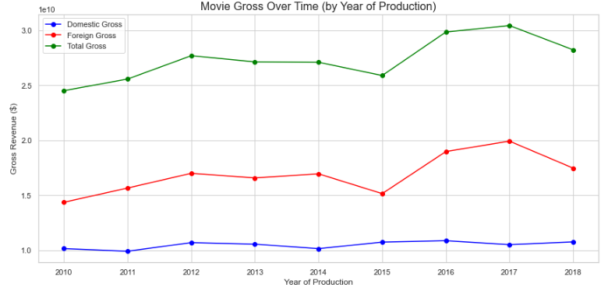
Conclusion: the trends in foreign gross and the domestic gross in general are steadily increasing over the years, and the dominant source of revenue is the foreign market.

Slide 13
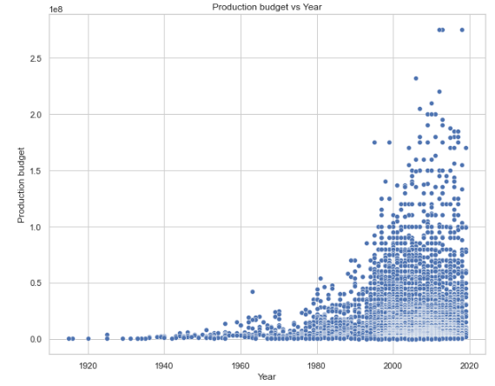
Conclusion: we can clearly see that the production budget has been increasing over the years. This is may be because of the demand for high-quality visual effects.

Slide 14
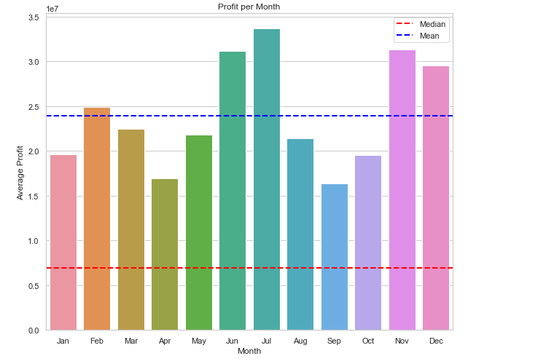
Conclusion: the industry appears to perform better than average in mid year, that is June and July, and end year in November and December. Therefore, it may be advisable for the client to schedule their release dates during these months to maximize potential returns.
Monthly performance

Slide 15
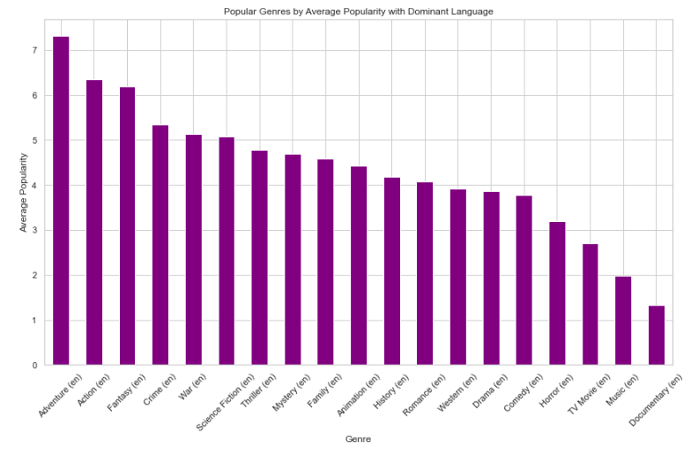
Conclusion:Based on the dominant language, English,adventure movies have a higher popularity compared to other genres

Slide 16
conclusion
Based on the analysis, the most profitable genres are Drama, Comedy, Action, and Adventure.
Universal Studios, BV, and Sony are the top-performing studios. It is recommended that the client benchmark or collaborate with these studios to enhance their market presence.
The foreign market contributes approximately 55% of the industry's total revenue. Therefore, the client should highly consider the foreign market when planning and producing movies to maximize revenue potential.
For every dollar spent on production, an additional $1.4521 in gross revenue is generated. This highlights the importance of investing strategically in production budgets.
Movies released mid-year (June and July) and end-year (November and December) generate the highest revenue. It is advisable for the client to schedule movie releases during these months to capitalize on peak performance periods.

Slide 17
conclusion
6. English is the dominant language in the movie industry, reaching the widest audience base compared to other languages. The client should consider producing movies primarily in English to maximize global reach and appeal.
7. a.) Gene Roddenberry, Vincent Gilligan, and Chris Morgan are among the top writers in the industry. The client is encouraged to explore hiring them for movie projects to ensure high-quality storytelling.
b.) Among the producers analyzed, Sergey stands out as the best performer. The difference between David and Paul is negligible, meaning selecting either one would likely yield similar results in movie performance.

Slide 18
The end

